Slide 1
Windows Persistence,
Lateral Movement,
Credential Access, and Review
Cybersecurity
Lesson 16.3

Slide 2

Class Objectives
By the end of today’s class, you will be able to:
1
Understand the role of a pen tester in assessing a business' security.
2
Perform lateral movement to other machines in a network.
3
Explain what DC replication is and how to use the DCSync attack.

Slide 3
Windows Credentials
Refresher
***

Slide 4
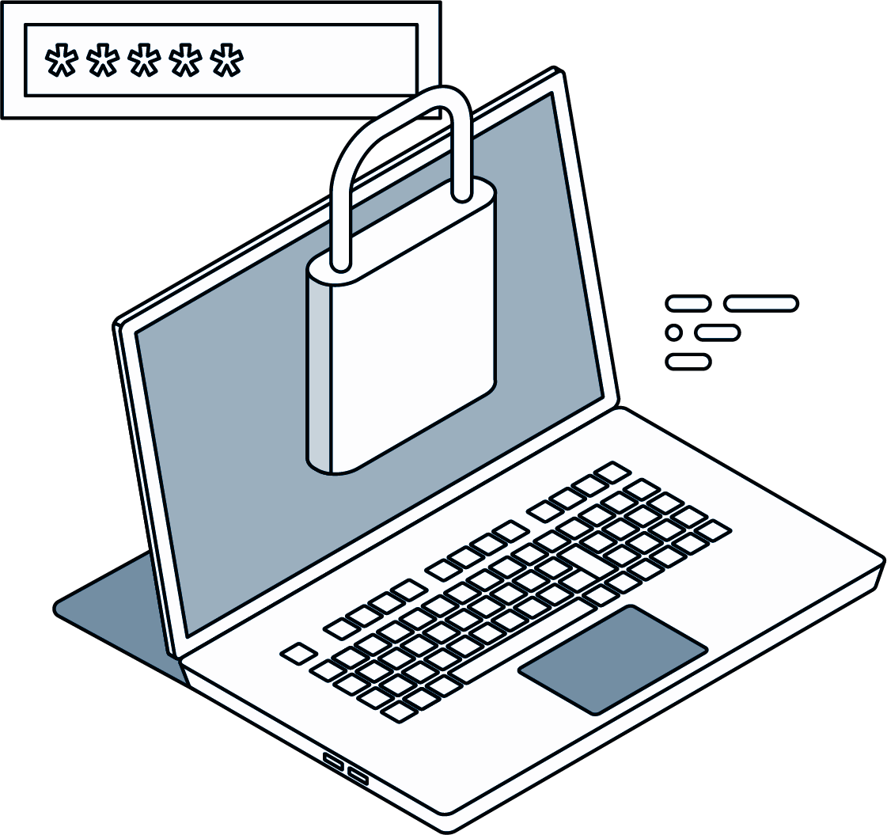
Windows Credentials Refresher
Now that we have escalated to SYSTEM privileges, we can dump credentials stored in Windows.
In Linux, we can dump credentials (usernames and hashes) by viewing the contents of the /etc/shadow file.
Notes:
shutterstock_782515144

Slide 5
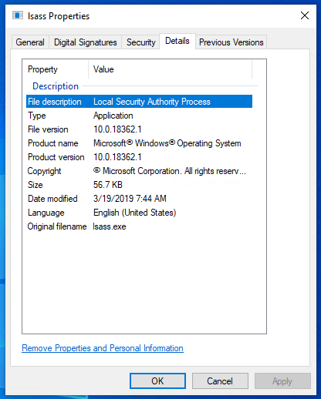
Windows Credentials Refresher
In Windows, credentials are stored in the Security Accounts Manager (SAM) database.
This database is stored within the Local Security Authority Subsystem Service (LSASS) process.
If we access LSASS, which is always run
as SYSTEM, we can dump the contents of
the process. This includes the SAM database and any credentials stored in it.

Slide 6

Windows Credentials Refresher
When a domain user logs in to Windows, their credentials are cached in the registry.
The registry is a database in Windows that stores settings for Windows and applications.
Local account
passwords are continuously stored in SAM and are always
available offline.
Domain accounts,
which primarily use Kerberos for authentication, do not
have their credentials stored in SAM.

Slide 7
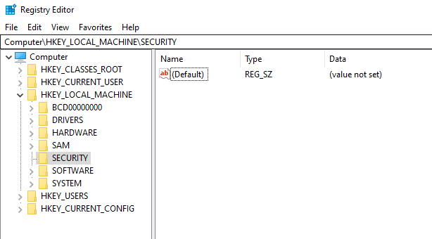
Windows Credentials Refresher
The registry setting is HKEY_LOCAL_MACHINE\Security\Cache, which is held in the file C:\Windows\System32\config\SECURITY.

Slide 8
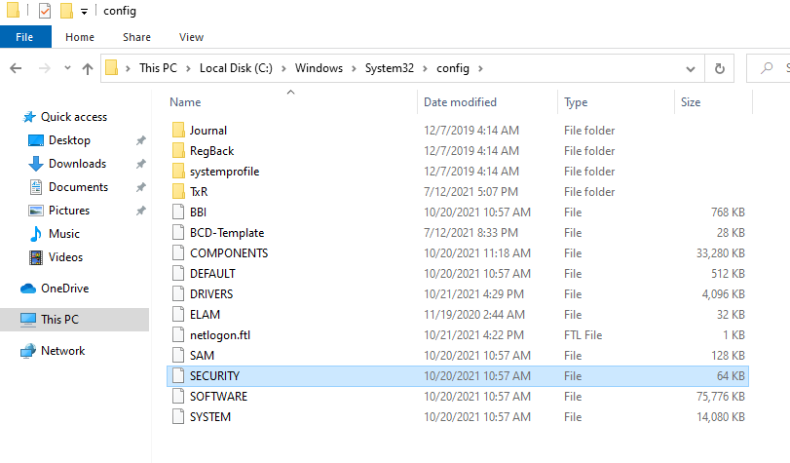

Windows Credentials Refresher
This specific registry key appears blank because it is only accessible by SYSTEM. However, the file C:\Windows\System32\config\SECURITY shows that it contains data.
This is not viewable as a standard user. You must be SYSTEM to access the file.

Slide 9
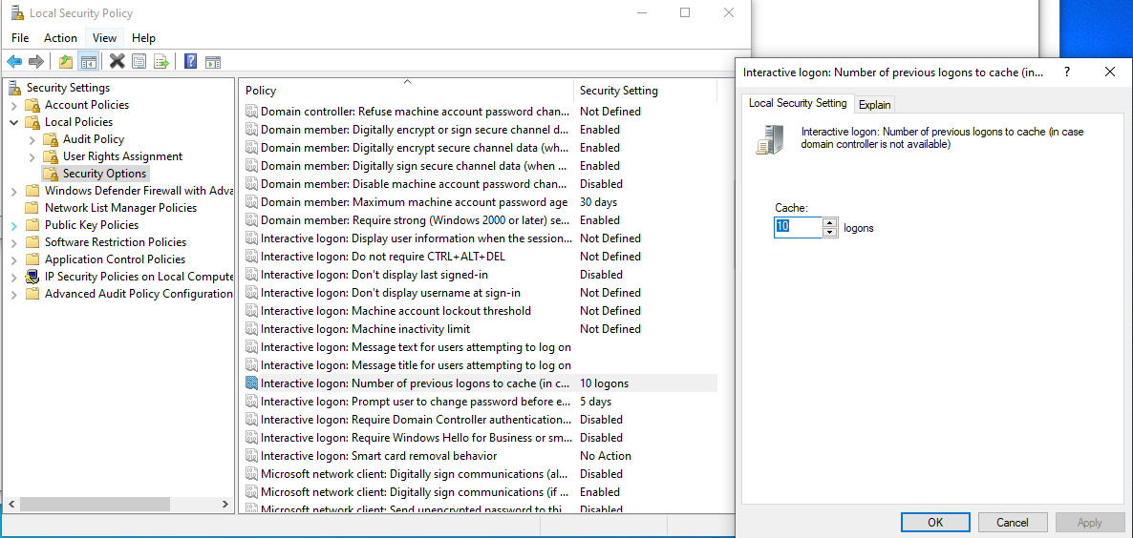
Windows Credentials Refresher
By default in Windows 10, up to 10 network or domain credentials are cached at a time. View this default value in the local security policy.

Slide 10
Mimikatz is a Windows-purposed credential dumping tool that can decrypt almost all stored credentials in Windows.

Slide 11

Mimikatz is a very complicated tool, so
we won’t dive into the
specifics of how it works.
We’ll use the
Metasploit version of Mimikatz called kiwi.
Notes:
shutterstock_1090246019

Slide 12
kiwi

Slide 13
Credential dumping
In this activity, you’ll dump credentials using kiwi.
Then you’ll save and crack the hashes using john.
15 minutes

Slide 16

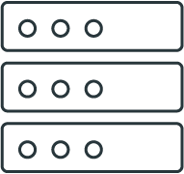

Lateral Movement

Slide 17
Lateral Movement
We have now:
Dumped domain credentials
Cracked their hashes
Established persistence on one machine
Next, we will learn how to expand our access on the network.

Slide 18

It’s rare for pen testers to complete their goal by accessing a single machine. Often, they need to move throughout the network, compromising other machines to either obtain the goal or get access to achieve the goal.
Notes:
shutterstock_453152185

Slide 19


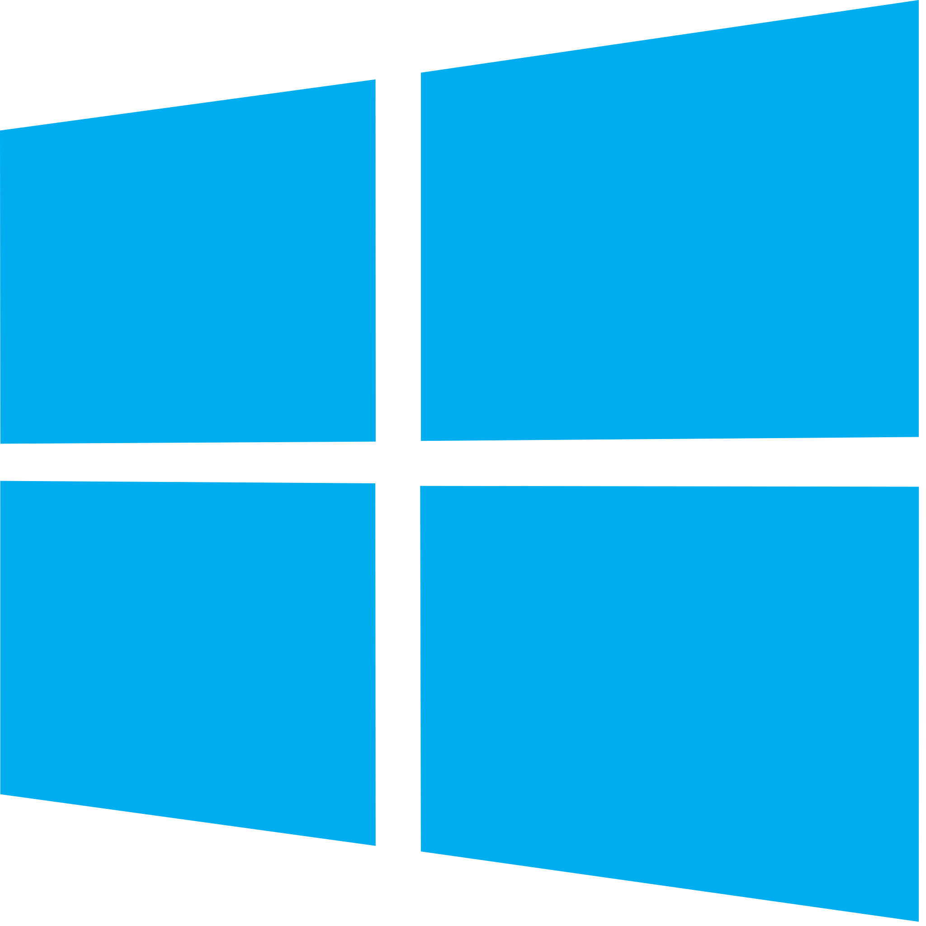

Lateral Movement
For example, our objective in this penetration test is to gain access to MegaCorpOne’s domain controller and steal its top-secret file.
Linux Machine
Windows Machine
Domain Controller
We obtained initial access
to a Linux machine and used credentials we’d found on it to compromise a Windows machine.
We obtained more credentials
on the Windows machine
and will now try to use those credentials elsewhere.
Our goal is to gain access
to credentials that can access
the domain controller (DC), WINDC01, where our
objective lies.
Notes:
shutterstock_213563017

Slide 20
Credential spraying

Slide 21
Lateral Movement

Slide 22
Lateral movement means moving through the network from one machine to another.

Slide 23
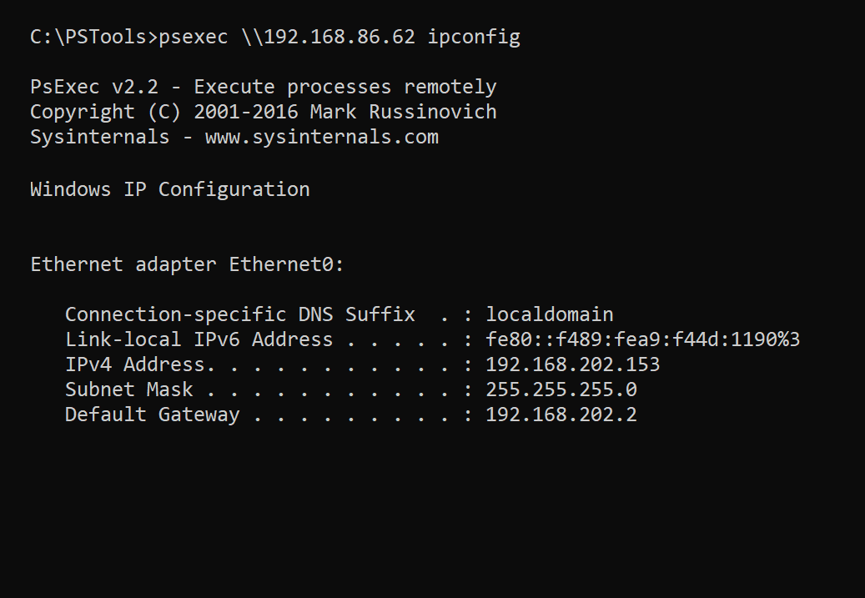
Lateral Movement
We can use several different techniques to achieve lateral movement.
Once again, we perform many of them by using Windows tools maliciously.
For example:
PsExec is a tool that manages Windows machines remotely using PowerShell.
For MegaCorpOne, we’ll leverage the
credentials that we gathered and cracked from the Windows 10 machine to move to the DC.

Slide 24
Lateral movement techniques often overlap with initial access techniques, as both tactics typically leverage the execution of code.

Slide 25

Lateral Movement
Two key differences between lateral movement and initial access exist:
01
02
Lateral movement requires already having internal network access, because “lateral” movement means moving inside the network.
Initial access refers only to the initial way that we get access to a machine on the internal network.
There’s often a greater number of possibilities for code execution when performing lateral movement.
Within an internal network, network firewall rules seldom apply and internally networked machines often have greater access to ports to other machines on the network.

Slide 26
Lateral Movement Techniques
Remote Services | An umbrella technique for any remote services on a machine—for example, SSH, VNC, and RDP. PsExec is a common lateral movement tool. It lets an administrator execute PowerShell commands remotely. A pen tester can remotely execute a malicious PowerShell payload on a remote machine to gain access to it.
Remote Services: Remote Desktop Protocol | Remote Desktop Protocol (RDP) will let a user log in to a machine remotely and control it as if they were physically logged in. Pen testers can leverage this by logging in to any machines their compromised user has RDP access to.
Exploitation of Remote Services | Exploitation of old services is also a common lateral movement technique. The SMB protocol has had several critical-severity vulnerabilities that allowed a pen tester to easily get SYSTEM privileges remotely over a machine.
Remote Services: SMB/Windows Admin Shares | This last example uses SMB to get access to a remote file system. In addition to serving the file system service, SMB is used in conjunction with another protocol, RPC, to transfer files or access services such as Task Scheduler or Service Controller.

Slide 27
Lateral movement
In this activity, we will use bbanner’s credentials to move laterally from Windows 10 to WINDC01.
15 minutes

Slide 30
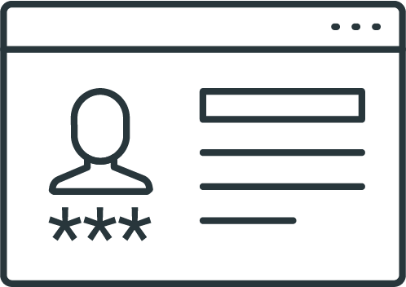
Credential Access

Slide 31
Since we now have access to WINDC01 from a SYSTEM Meterpreter shell, we have unfettered access to the entire domain.

Slide 32
Credential Access
We now control two key pieces of the Active Directory (AD) domain:
bbanner Account
WINDC01
Part of the Domain Administrator group in AD
This means that we have the ability to log in to any machine by default to create and delete accounts, reset passwords, etc.
The primary DC for the domain
This is the machine that handles network logins, access control
for network assets, etc.

Slide 33

Credential Access
Having SYSTEM or Administrator access to a DC means that, directly or indirectly, you have access to every single domain user’s password hash, which can be exfiltrated and then cracked offline.
Storing Hashed Passwords
Customer
Authentication Server
Validate password requirements
Hash password
Save
new user
Username
Password
NTDS.dit Database

Slide 34
One network can contain multiple DCs.
Credential Access
Often, there’s a “primary” that handles the Kerberos authentication and other services, such as DNS.
“Secondary” DCs often have other services running, such as file shares
and VoIP services.
However, if secondary DCs are configured with domain services, they can act as backups to the primary DC.
Established persistence on one machine
Primary
Database
Secondary
Database

Slide 35

Credential Access
In the event
the primary DC goes
down, the secondary DC
handles authentication.
For this to happen,
the secondary DC
must replicate the data
from the primary DC.

Slide 36
Credential Access
The ability to replicate data from a DC is a reserved privilege for DC computer accounts or domain administrators.
User password hashes are stored on disk on the primary DC inside the file:
Historically, this file was heavily targeted by pen testers.
However, due to changes in how the hashes are actually
stored and how the NTDS.dit file is read, this technique
is not applicable to Windows 10+ and Server 2016+.
C:\Windows\System32\NTDS.dit

Slide 37
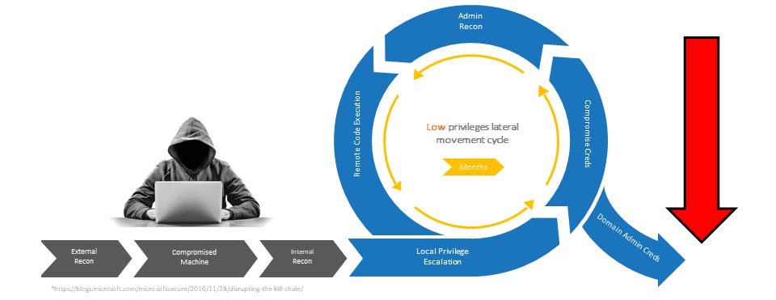


DCSync
The newer, preferred technique for accessing password hashes on DCs is called DCSync. It involves replicating the data from a domain controller and parsing through it to extract the password hashes for users.
This technique was discovered by the creator of Mimikatz, Benjamin Delpy.
+
Attacker gains access to a machine with AD replication privileges.
Attacker replicates
credentials data from the DC.
Attacker parses through the data to extract user password hashes.

Slide 38
DCSync
DCSync requires replication rights, so you must have a domain administrator account or be SYSTEM on a DC itself.
DCSync does not have a standalone Metasploit module, however
we can use kiwi to perform DCSync.
There’s one major difference between DCSync in kiwi and the .exe
version of Mimikatz: In kiwi, you must specify a username with the password hash you want. The .exe version of Mimikatz will return
all users’ password hashes when performing DCSync.
Established persistence on one machine

Slide 39
Credential access

Slide 40
Credential access
In this activity, you will perform DCSync on the WINDC01 machine
and recover password hashes for users.
Due to the limitations of kiwi in Metasploit, the instructions will inform you which usernames to DCSync.
15 minutes

Slide 44
Weekly Recap: Windows Penetration Testing
Day 1
Day 2
Day 3
We began by illustrating the similarities and differences between Linux and Windows
pen testing.
We moved on to scanning and learning what ports Windows machines
have open.
Then we conducted authentication attacks with password spraying and LLMNR poisoning.
We also exploited our target with WMI to run commands remotely
on the target machine.
We began by using msfvenom
to create custom payloads, which gave us a Meterpreter shell to conduct post-exploitation.
Next we learned several privilege escalation techniques, how to conduct process migration, as well as several windows persistence techniques.
We learned how to use
Mimikatz to extract passwords from memory.
Then we learned several lateral movement techniques to access other machines.
We then concluded this week’s lesson by using DCSync to access password hashes on DCs.

Slide 45

To finish class, we’ll review what we’ve learned about pen testing with a game of

Slide 46
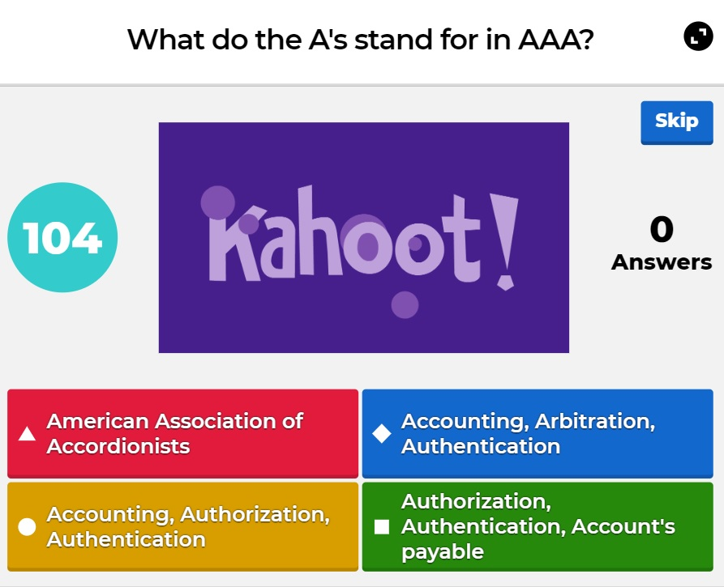

What’s Kahoot?
Kahoot! is a web-based tool that:
Displays questions and answers to select from
in real time.
Keeps track of individual and team scores.
Keeps track of remaining time for each question.

Slide 47


Rules and Guidelines
There are a total of 30 questions.
Points are not deducted for
incorrect answers.
You will have two minutes to answer each question.
If you are competing as a team,
select a team captain to answer
the questions.
Points are awarded for correct answers and for how quickly you answer compared to your classmates.
Note: If your class is currently online,
it will be easier if each student competes individually.

Slide 48
Start the Kahoot! Pen Testing Week 2 Challenge by accessing the link:
Kahoot! Pen Testing Week 2 Challenge

Slide 49
Setup
01
Select Play if you are logged in. Select Play as Guest if you do not have
a Kahoot! account.
02
Select Classic if you are competing individually and Team Mode if you are competing in a group.
03
Leave all the other options as default.
04
Follow the instructions on the screen by going to kahoot.it.
05
Enter the unique Kahoot! code.
06
Select Start to begin.

